Slide 1
3 Female Characters in The Awakening
Differences and Alikeness among Edna, Adele and Mademoiselle Reisz
宁若汐

Slide 2
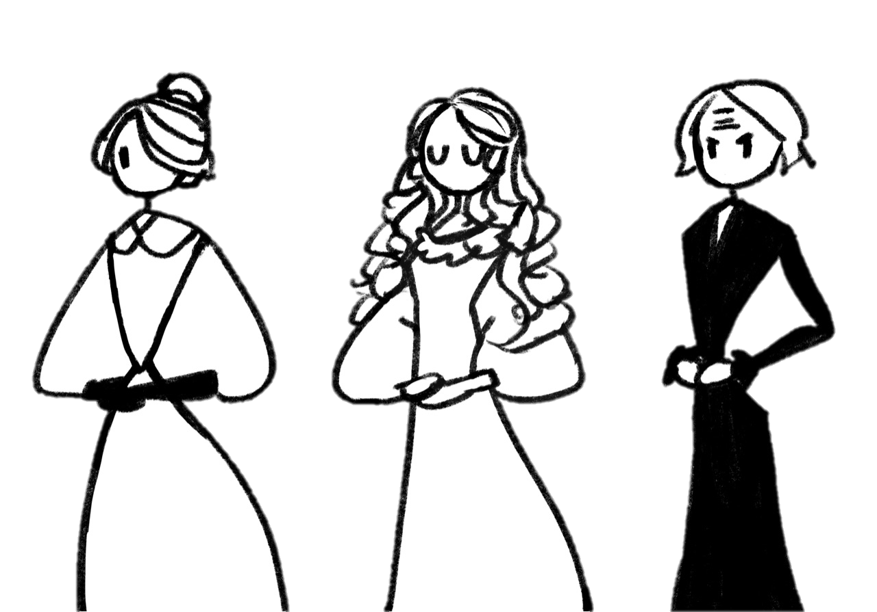
1
Introduction to the Plot
2
Differences
3
Alikeness

Slide 3
1
Introduction to the Plot

Slide 4
A young mother,
‘s struggling
to achieve sexual and personal emancipation
in the patriarchal environment
of the postbellum(战后的) American South
Edna Pontellier
During the summer vacation to Grand Isle, she met 2 female friends
and
And fell in love with a playboy, Robert.
As her understanding Adele, Reisz and Robert develops,
Adele Ratignolle
Mademoiselle Reisz
Edna gradually established a self-consciousness as an independent human being.
Finally, she left her family and broke up with Robert, and committed suicide to achieve fully emancipation.

Slide 5
2
Differences

Slide 6
Appearances
Edna: nontraditional mother and housewife
“MRS. PONTELLIER’S EYES were quick and bright; they were a yellowish brown, about the color of her hair. She had a way of turning them swiftly upon an object and holding them there as if lost in some inward maze of contemplation or thought. Her eyebrows were a shade darker than her hair. They were thick and almost horizontal, emphasizing the depth of her eyes. She was rather handsome than beautiful. Her face was captivating by reason of a certain frankness of expression and a contradictory subtle play of features. Her manner was engaging.”

Slide 7
Appearances
Adele: ideal mother and housewife
“There are no words to describe her save the old ones that have served so often to picture the bygone heroine of romance and the fair lady of our dreams. There was nothing subtle or hidden about her charms; her beauty was all there, flaming and apparent: the spun-gold hair that comb nor confining pin could restrain; the blue eyes that were like nothing but sapphires; two lips that pouted, that were so red one could only think of cherries or some other delicious crimson fruit in looking at them. She was growing a little stout, but it did not seem to detract an iota from the grace of every step, pose, gesture. One would not have wanted her white neck a mite less full or her beautiful arms slenderer. Never were hands more exquisite than hers, and it was a joy to look at them when she threaded her needle or adjusted her gold thimble to her taper middle finger as she sewed away on the little night-drawers or fashioned a bodice or a bib.”

Slide 8
Appearances
Reisz: a single but independent musician
“She was a disagreeable little woman, no longer young, who had quarreled with almost every one, owing to a temper which was self-assertive and a disposition to trample upon the rights of others.”
“She made an awkward, imperious little bow as she went in. She was a homely woman, with a small weazened face and body and eyes that glowed. She had absolutely no taste in dress, and wore a batch of rusty black lace with a bunch of artificial violets pinned to the side of her hair.”

Slide 9
Hobbies
Edna
Adele
Reisz
1. Listening to Reisz playing music
2. Painting
To express herself
Music
To educate her children, serve the guests and please her husband
Music
To make a living and express herself

Slide 10
Way of Treating Children
Edna: twin boys
(Mr. Pontellier)”his wife failed in her duty toward their children…In short, Mrs. Pontellier was not a mother-woman. If one of the little Pontellier boys took a tumble whilst at play, he was not apt to rush crying to his mother’s arms for comfort; he would more likely pick himself up, wipe the water out of his eves and the sand out of his mouth, and go on playing. “(p.10)
“She was fond of her children in an uneven, impulsive way. She would sometimes gather them passionately to her heart; she would sometimes forget them.” (P. 23)

Slide 11
Way of Treating Children
Adele: give birth to a child every 2 years
(the mother-women)
1. “They were women who idolized their children, worshiped their husbands, and esteemed it a holy privilege to efface themselves as individuals and grow wings as ministering angels.”
2. Spends all her time, sewing the clothes, playing the piano to amuse them or simply spending time taking care of them.
3. In chapter 37, there’s also a scene describing her giving birth and die from that. Her last words was to Edna: “Think of my children!”

Slide 12
Way of Treating Children
Reisz
no children

Slide 13
Way of Treating Love
Edna
“She grew fond of her husband, realizing with some unaccountable satisfaction that no trace of passion or excessive and fictitious warmth colored her affection, thereby threatening its dissolution. “(p.23)
2. “Are you in love with Robert?” “Yes!” (p.86)
3. Left her family and show her love towards Robert.

Slide 14
Way of Treating Love
Adele
In Male-hegemonic society, a woman’s beautiful appearance was believed as the weapon to capture men’s heart or was the symbol of fortune and position for men who got them.
Care about her feminine beauty very much.

Slide 15
Way of Treating Love
Reisz
“’If I were young and in love with a man,’ said Mademoiselle, turning on the stool and pressing her wiry hands between her knees as she looked down at Edna, who sat on the floor holding the letter, ‘it seems to me he would have to be some grand esprit; a man with lofty aims and ability to reach them; one who stood high enough to attract the notice of his fellowmen. It seems to me if I were young and in love I should never deem a man of ordinary caliber worthy of my devotion.’”(p.86)

Slide 16
General Description
Edna
Adele
Reisz
An awakening woman
A free soul
A sleeping angle
in the house
A grotesque freak
A monster in men’s eyes

Slide 17
3
Alikeness
Appearances:
discribed(observed and judged) again and agian
Love:
compulsory choice instead of a voluntary ones
Ending:
miserable

Slide 18
3
Alikeness
Victims to the patriarchal society

Slide 19
References
[1]Kate Chopin. The Awakening. 2008
[2]张婷. 父权制下的挣扎——从《觉醒》中人物形象分析凯特·肖邦的女性观 [D].内蒙古大学,2011.
[3]赵永乐. 《觉醒》中女性人物的分析[D].东北林业大学,2010.
[4]余小芳.声音与权威 ——从女性叙事学视角看《觉醒》中的女性角色[D].华中师范大学,2014.
[5]蔡秋晶. 觉醒和抉择 ——《觉醒》中三位女性人物比较研究[D].武汉轻工大学,2016.

